Slide 1
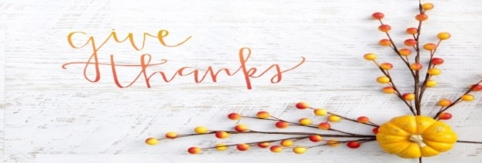
UC Davis 教授罗伯特 UC Davis, professor Robert
一周感恩五次，這樣的人会活的更健康，更善于应付压力。
He found out that he who give thanks five times a week will become healthier and better at coping with stress.

Slide 2
感恩会使体内的血清素和多巴鞍升高，这2种化学物质可以令人产生愉悦感和满足感。
He who gives thanks will increase serotonin and dopamine content in his body. These two chemicals make people feel pleasure and satisfaction.

Slide 3
献上感恩 Give Thanks
民数记11：1 Num. 11:1
提前6:7-8 1 Timothy 6:7-8
帖前5:18 1 The. 5:18

Slide 4
一、去除抱怨的习惯
「众百姓发怨言，他们的恶语达到耶和华的耳中。耶和华听见了就怒气发作，使火在他们中间焚烧，直烧到营的边界。」(民11:1)

Slide 5
1. Get rid of Complaining
Now the people complained about their hardships in the hearing of the Lord, and when he heard them his anger was aroused. Then fire from the Lord burned among them and consumed some of the outskirts of the camp. (Numbers 11:1)

Slide 6
「發怨言 」希伯來文是指人的期待和結果不同時，說出不好的話。
‘Complaining’ in Hebrew means saying bad things when a person’s expectation and the actual outcome are different.

Slide 7
「惡語 」是指人的心思意念充滿負面思想，對神產生不信任。
‘Wickedness ’ in Hebrew means to distrust God when a person’s mind is filled with negative thoughts.

Slide 8
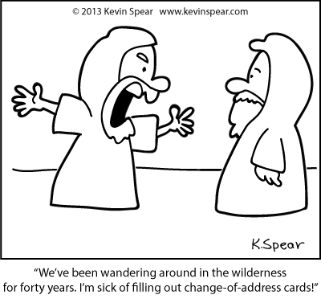
「你们也不要发怨言，像他们有发怨言的，就被灭命的所灭；他们遭遇这些事，都要作为鉴戒，并且写在经上，正是警戒我们这末世的人。」（林前10 :10-11）

Slide 9
And do not grumble, as some of them did—and were killed by the destroying angel. These things happened to them as examples and were written down as warnings for us, on whom the culmination of the ages has come. (1 Corn. 10:10-11)

Slide 10
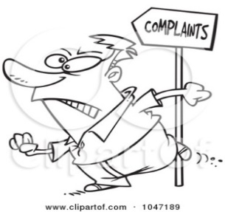
常常发怨言变成生活习惯的人 Life of people who complains
對神不信任
Not trusting God
自我为中心，心中沒有神
Self-centeredness, godless in his eyes
神是生活的附属品
God is his accessory

Slide 11
「 弟兄们，你们要谨慎，免得你们中间或有人存着不信的恶心，把永生神离弃了。」（來3:12）

Slide 12
See to it, brothers and sisters, that none of you has a sinful, unbelieving heart that turns away from the living God. (Hebrews 3:12)

Slide 13
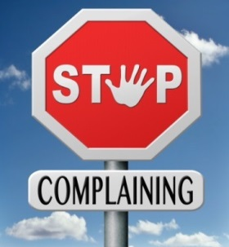
一旦察觉到自己陷入抱怨时，赶快认罪悔改，来信靠神，我们就能进入有神同在的安息所。
Once we complained about our situation, we must confess our sins to God and trust in Him. We will then enter His presence.

Slide 14
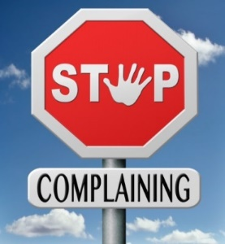
用感谢和赞美神來取代抱怨，神的大能将会在我们身上动工。
Give thanks and praise God to replace complaining, His Power will then do wonderful things for us.
「除去抱怨的运动」
The movement to stop complaining

Slide 15
二、知足感恩的态度 The Attitude of Gratitude
「因为我们没有带什么到世上来，也不能带什么去。只要有衣有食，就当知足。」(提前6:7-8)
For we brought nothing into the world, and we can take nothing out of it. But if we have food and clothing, we will be content with that. (1 Timothy 6:7-8)

Slide 16
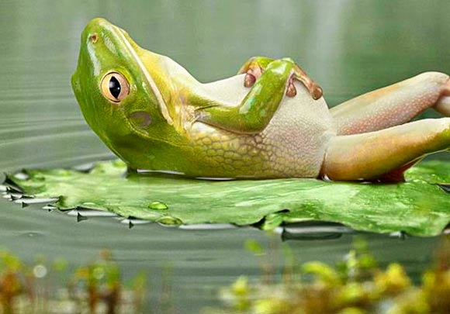
「知足 」在希臘文是指人處在任何環境下用正面思想帶來滿足感。
‘Contentment’ in Greek means to use positive thoughts under any circumstances to bring satisfaction.

Slide 17
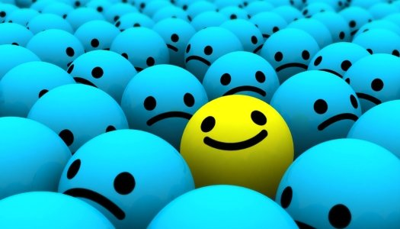
使徒保罗的见证
「我无论在什么景况，都可以知足，这是我已经学会了。我知道怎样处卑贱，也知道怎样处丰富、或饱足、或饥饿、或有余、或缺乏，随事随在我都得了秘诀，我靠着那加给我力量的，凡事都能作。 」（腓4:11-13）

Slide 18
Testimony of apostle Paul
I am not saying this because I am in need, for I have learned to be content whatever the circumstances. I know what it is to be in need, and I know what it is to have plenty. I have learned the secret of being content in any and every situation, whether well fed or hungry, whether living in plenty or in want. I can do all this through him who gives me strength. (Philippians 4:11-13)

Slide 19
使徒保罗的见证 Testimony of Apostle Paul
对现在所处的处境感到知足。
Be content with any circumstances.
无论顺境或逆境都感谢神，我们将会知足并带来许多的福气。
Give thanks to God in both good and bad situations. We will then be content and receive even more blessings.

Slide 20
三、凡事谢恩的操练 The practice of gratitude
「凡事谢恩；因为这是神在基督耶稣里向你们所定的旨意。」
(帖前5:18)
Give thanks in all circumstances; for this is God’s will for you in Christ Jesus. (1 The. 5:18)

Slide 21
「凡事謝恩 」希臘文是指在任何境況下，大大小小的事都要感謝神。
‘Give thanks in all circumstances’ in Greek means to give thanks to God in all sorts of situation, regardless of how major they may be.

Slide 22
三、凡事谢恩的操练 The practice of gratitude
真正改变这个世界的是将抱怨转化为异象的人。
He who can change the world is one who turns complaints into visions.

Slide 23
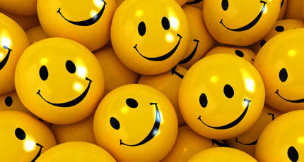
操练「凡事谢恩」 The practice of “Giving thanks”
为「已得到的，曾经拥有的」或「正失去或在苦难中」感谢神
Thank God for what I gained/once had or am losing/suffering.

Slide 24
懂得感恩的人是一位积极的人！
A positive person knows how to give thanks!
懂得感恩的人是一位充满活力的人！
An energetic person knows how to give thanks!

Slide 25
懂得感恩的人是一個快乐的人！
A happy person is one who knows how to give thanks!

Slide 26
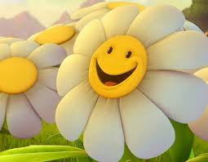
默想时刻 Meditation time
1. 今年有没有值得向神感恩及向人感谢的事？
Is there anything worth giving thanks to this year?

Slide 27
默想时刻 Meditation time
2. 一生中我们有没有值得感恩的事？
Is there anything in our lives worth giving thanks to?

