Slide 1
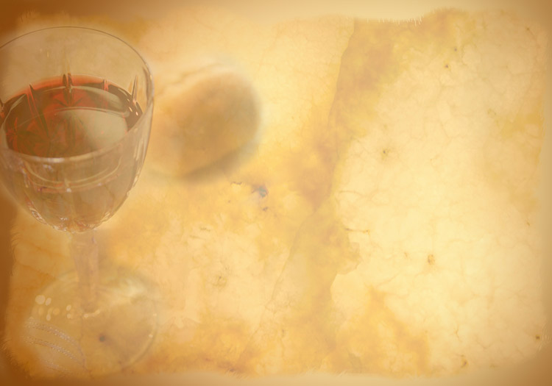
为的是记念我
In Remembrance of Me
题目：纪念主
经文：马太福音26：26－29；
哥林多前书11：23－26
Topic: Remember the Lord
Text: Matthew 26:26-29;
I Corinthians. 11:23-26

Slide 2
为的是记念我
In Remembrance of Me
（26）他们吃的时候、耶稣拿起饼来、祝福、就擘开、递给门徒、说、你们拿着吃．这是我的身体。（27）又拿起杯来、祝谢了、递给他们、说、你们都喝这个．（28）因为这是我立约的血、为多人流出来、使罪得赦。（29）但我告诉你们、从今以後、我不再喝这葡萄汁、直到我在我父的国里、同你们喝新的那日子。（太26：26－29）

Slide 3
为的是记念我
In Remembrance of Me
（23）我当日传给你们的、原是从主领受的、就是主耶稣被卖的那一夜、拿起饼来、（24）祝谢了、就擘开、说、这是我的身体、为你们舍的．你们应当如此行、为的是记念我。（25）饭後、也照样拿起杯来、说、这杯是用我的血所立的新约．你们每逢喝的时候、要如此行、为的是记念我。（26）你们每逢吃这饼、喝这杯、是表明主的死、直等到他来。（林前11：23－26）

Slide 4
为的是记念我
In Remembrance of Me
²³ For I received from the Lord what I also passed on to you: The Lord Jesus, on the night he was betrayed, took bread, ²⁴ and when he had given thanks, he broke it and said, “This is my body, which is for you; do this in remembrance of me.” ²⁵ In the same way, after supper he took the cup, saying, “This cup is the new covenant in my blood; do this, whenever you drink it, in remembrance of me.” ²⁶ For whenever you eat this bread and drink this cup, you proclaim the Lord’s death until he comes. (1 Cor. 11:23-26)

Slide 5
为的是记念我
In Remembrance of Me
1. 纪念“主耶稣”
“你们应当如此行，为的是纪念我。”
（林前11：24）
1. Remember the “Lord Jesus”
“...do this in remembrance of me”
(1 Cor. 11:24)

Slide 6
为的是记念我
In Remembrance of Me
“能以和众圣徒一同明白基督的爱、是何等长阔高深”（弗3：18）
“…to grasp how wide and long and high and deep is the love of Christ” (Ephesians 3:18)

Slide 7
为的是记念我
In Remembrance of Me
高
长
阔
深

Slide 8
为的是记念我
In Remembrance of Me
2. 纪念主所立的“新约”
“这杯是用我的血所立的新约。”
（林前11：25）
2. Remember the “new covenant”
“This cup is the new covenant in my blood”
(1 Cor. 11:25)

Slide 9
为的是记念我
In Remembrance of Me
“但这些祭物是叫人每年想起罪来。因为公牛和山羊的血、断不能除罪。”（来10：3，4）
“But those sacrifices are an annual reminder of sins. It is impossible for the blood of bulls and goats to take away sins.” (Hebrews 10:3,4)

Slide 10
为的是记念我
In Remembrance of Me
“因为这是我立约的血、为多人流出来、使罪得赦”（太26：28）
“This is my blood of the covenant, which is poured out for many for the forgiveness of sins.” (Matthew 26:28)

Slide 11
为的是记念我
In Remembrance of Me
“我也不定你的罪。去吧，从此不要再犯罪了。”（约8：11）
“Then neither do I condemn you ,” Jesus declared. “Go now and leave your life of sin.” (John 8:11)

Slide 12
为的是记念我
In Remembrance of Me
“并要以恩慈相待，存怜悯的心，彼此饶恕，正如神在基督里饶恕了你们一样。”（弗4：32）
Be kind and compassionate to one another, forgiving each other, just as in Christ God forgave you. (Ephesians 4:32)

Slide 13
为的是记念我
In Remembrance of Me
3. 纪念主的血是为“多人流出来”的
“因为这是我立约的血、为多人流出来、使罪得赦”（太26：28）
3. Remember the blood of Christ was “poured out for many”
“This is my blood of the covenant, which is poured out for many for the forgiveness of sins.” (Matthew 26:28)

Slide 14
为的是记念我
In Remembrance of Me
“他为我们的罪作了挽回祭．不是单为我们的罪、也是为普天下人的罪。”（约壹2：2）
“He is the atoning sacrifice for our sins, and not only for ours but also for the sins of the whole world.”(1 John 2:2)

Slide 15
为的是记念我
In Remembrance of Me
4. 纪念主的“再来”
“你们每逢吃这饼、喝这杯、是表明主的死、直等到他来。”（林前11：26）
4. Remember the “second coming of Christ”
“For whenever you eat this bread and drink this cup, you proclaim the Lord’s death until he comes.” (1 Cor. 11:26)

Slide 16
为的是记念我
In Remembrance of Me
“加利利人哪、你们为甚麽站着望天呢．这离开你们被接升天的耶稣、你们见他怎样往天上去、他还要怎样来。”（徒1：11）
“Men of Galilee,” they said, “why do you stand here looking into the sky? This same Jesus, who has been taken from you into heaven, will come back in the same way you have seen him go into heaven.” (Acts 1:11)

Slide 17
为的是记念我
In Remembrance of Me
纪念他为我们舍了他的生命; 纪念他用他的血与我们立了新约; 纪念他的血是为多人流出来的; 纪念他要再来。
Remember the Lord who gave up His life, remember the covenant in His blood, remember His blood was poured out for many, remember the His second coming.

